Slide 1
Discovering Insights from Outputs ~Exploratory Visualization and Reporting Through R~
EPIS Annual Electric Market Forecasting Conference
September 16th, 2016
Eina Ooka: eooka@teainc.org

Slide 2

Agenda
The use of AURORAxmp at The Energy Authority
Examples of output visualization and Insights
Modeling and reporting routines
Reporting Tools

Slide 3
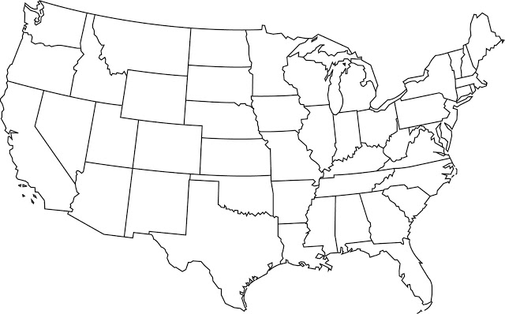
TEA & AURORA
The Energy Authority (TEA) is a public power-owned, nonprofit corporation.
We provide portfolio management and advisory services for utilities across the country.
TEA uses AURORAxmp for long-term zonal market simulation.
There are very small number of AURORA users at TEA. This forces us to be efficient in producing required AURORA results.

Slide 4
Projects using AURORAxmp
Long-Term Market Simulation for
Integrated Resource Planning
Non-Standard Risk Analysis
Resource acquisitions and divestures
Technical Studies for Community Choice Aggregation (CCA)
Need to capture effects of
Variable generation and distributed resources
Carbon allowance prices & taxes
Clean Power Plan
Negative load growth
Other long-term structural market changes

Slide 5
Results from LT WECC Model: 2016 - 2040
Finding Insights from Model Results

Slide 6
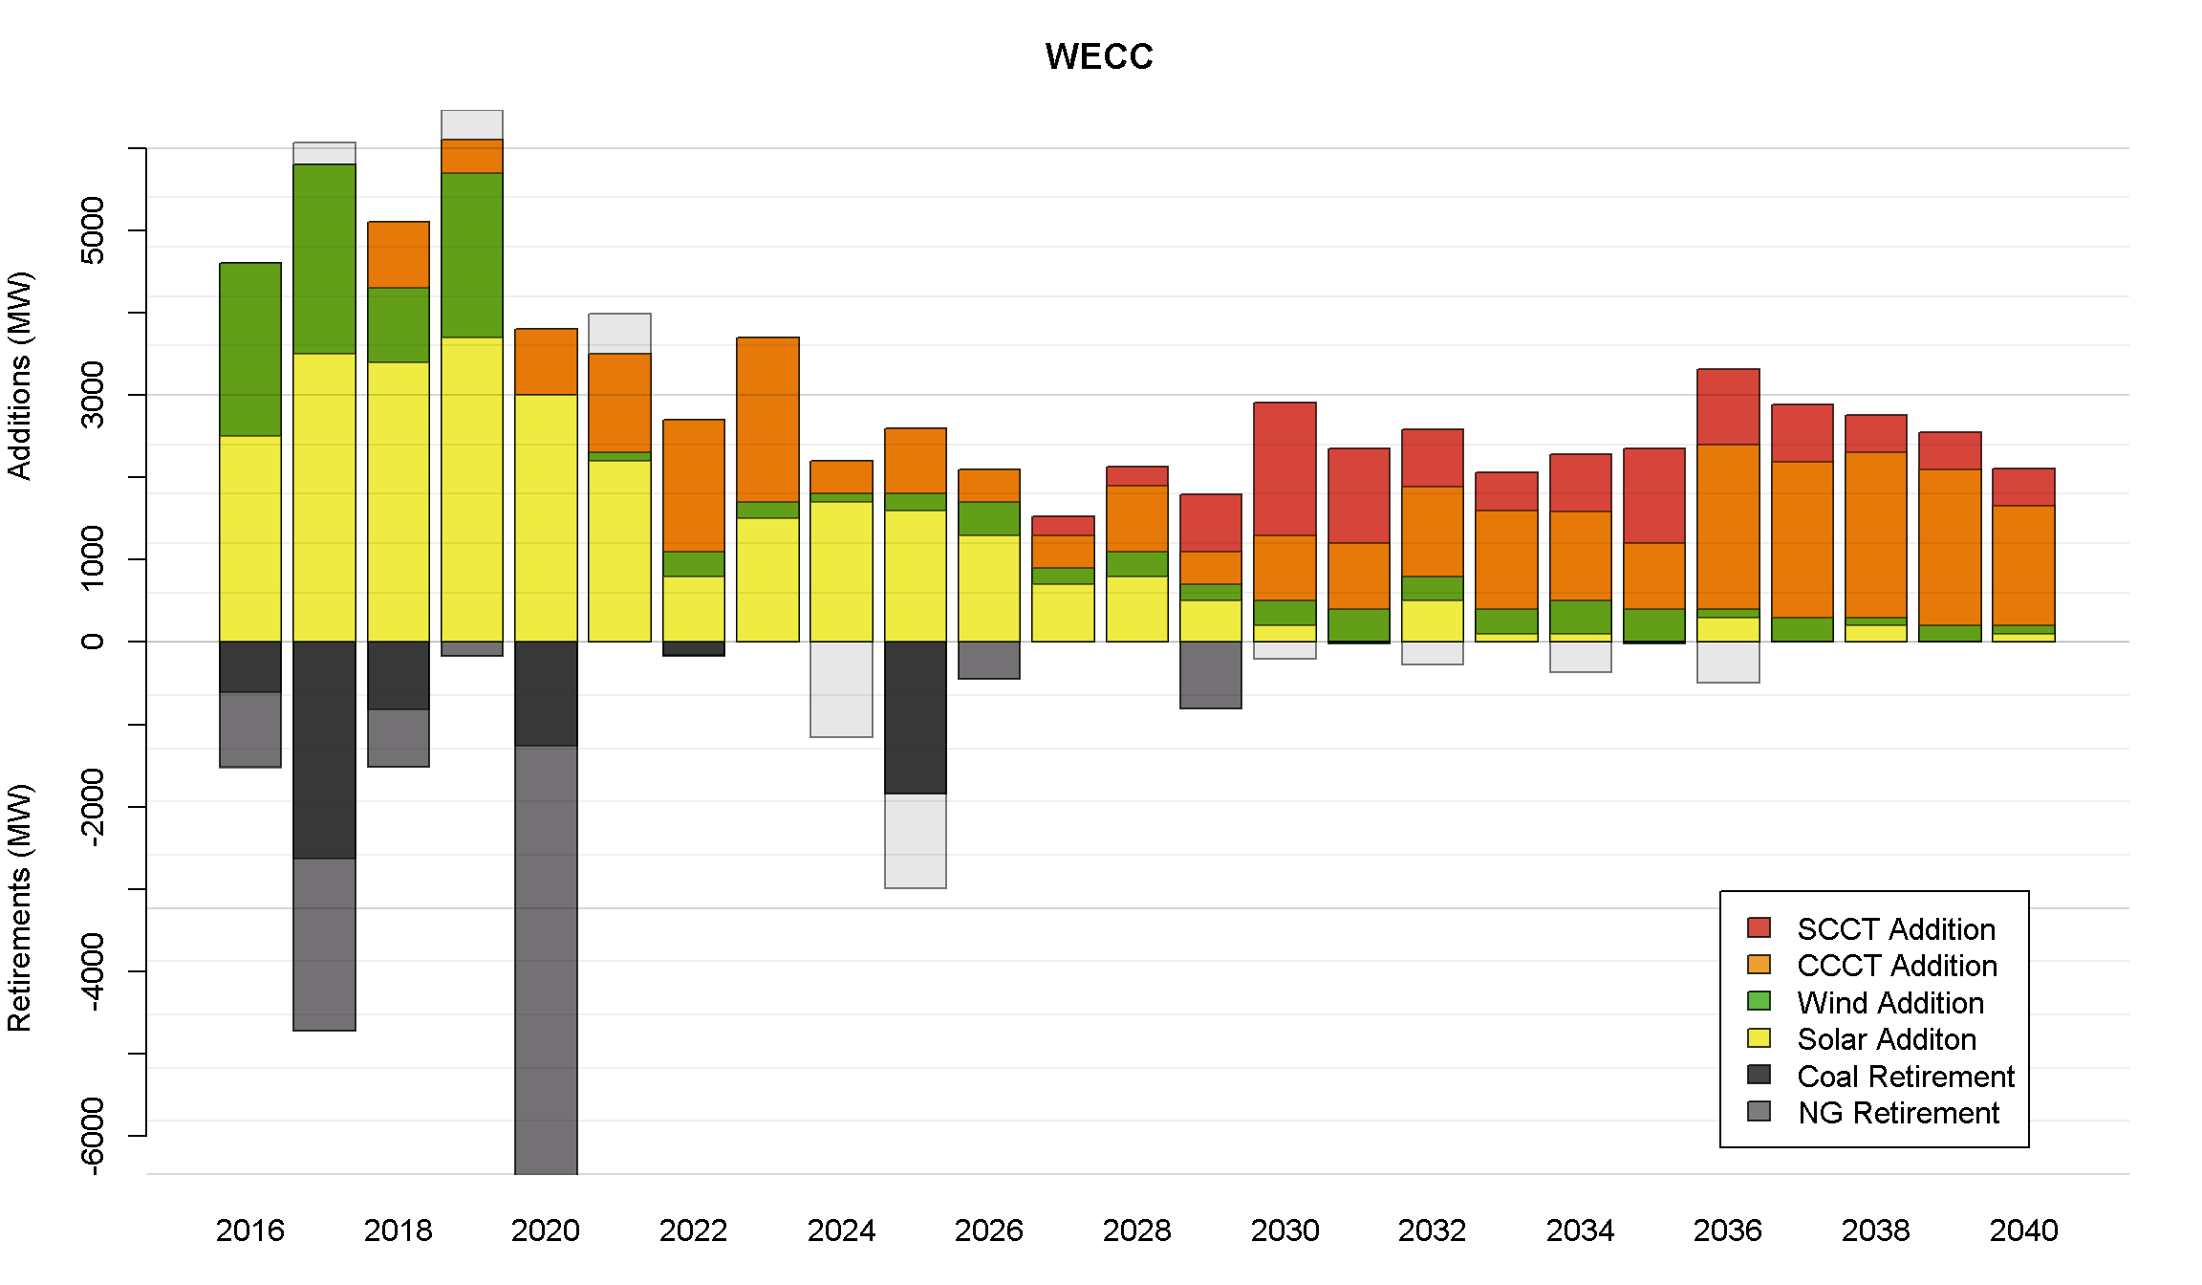
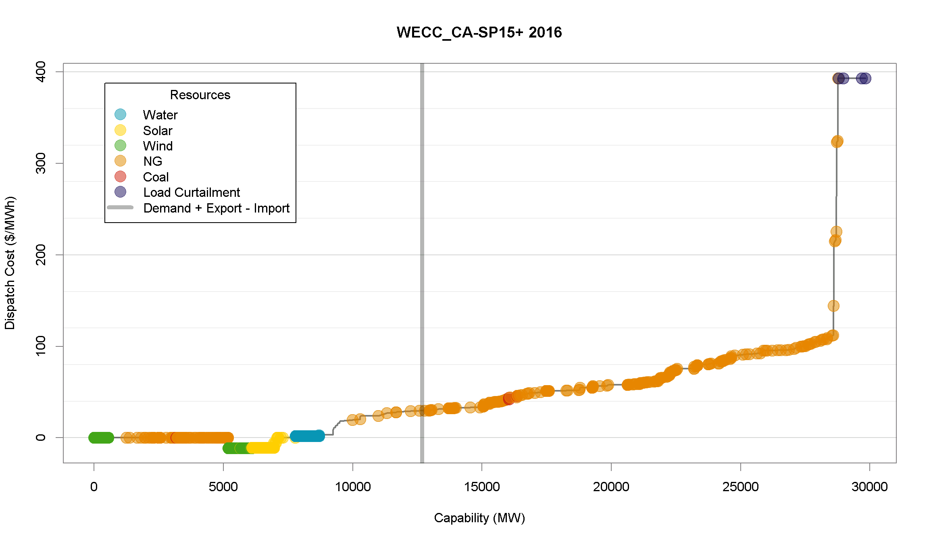
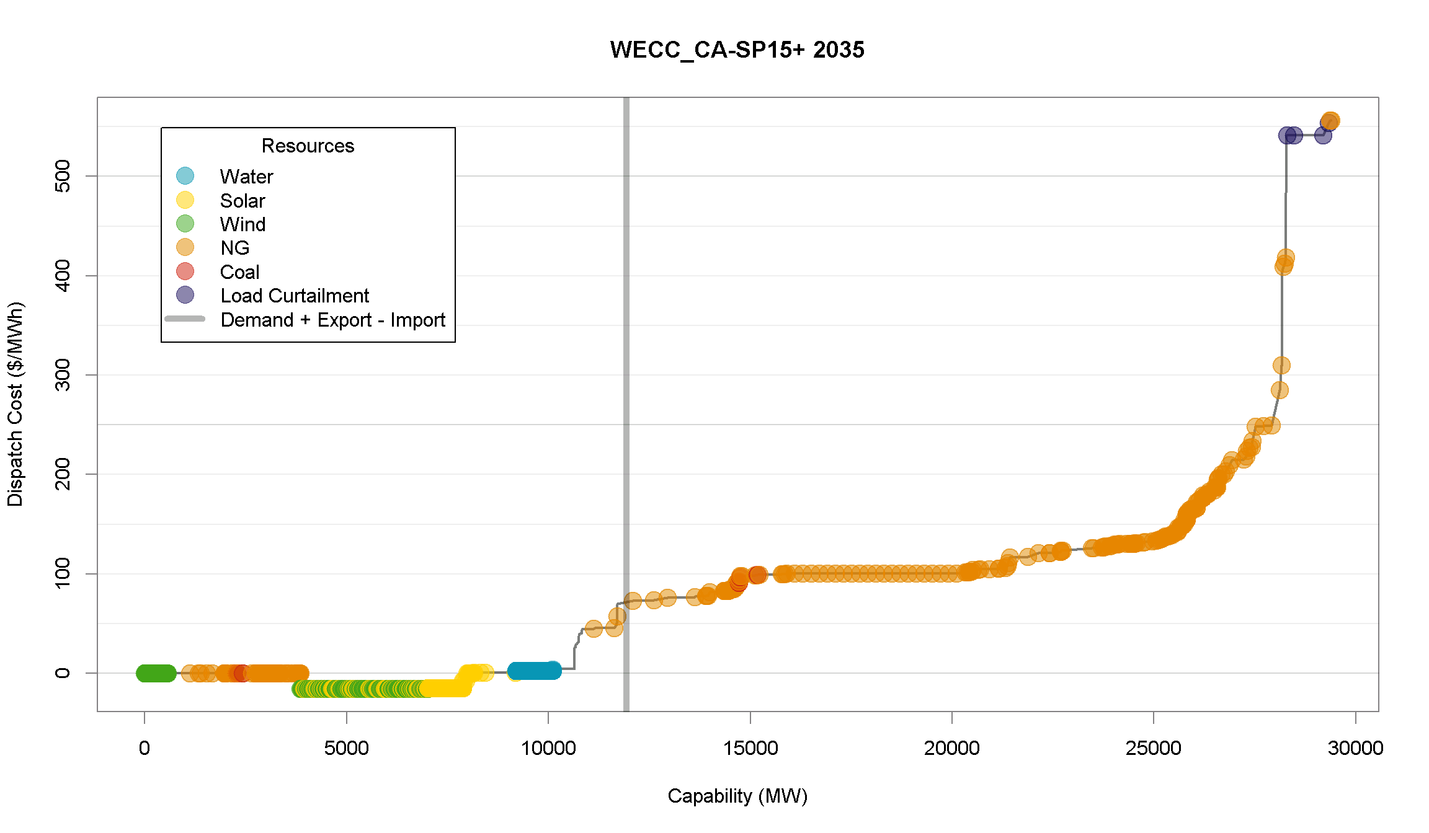
Resource Stack
What are the resource additions and retirements?
Scheduled and optimized.
WECC Resource Additions and Retirements 2016-2040
California SP15 2016
California SP15 2035
How does the overall resource stack look?
How does it change over time?

Slide 7
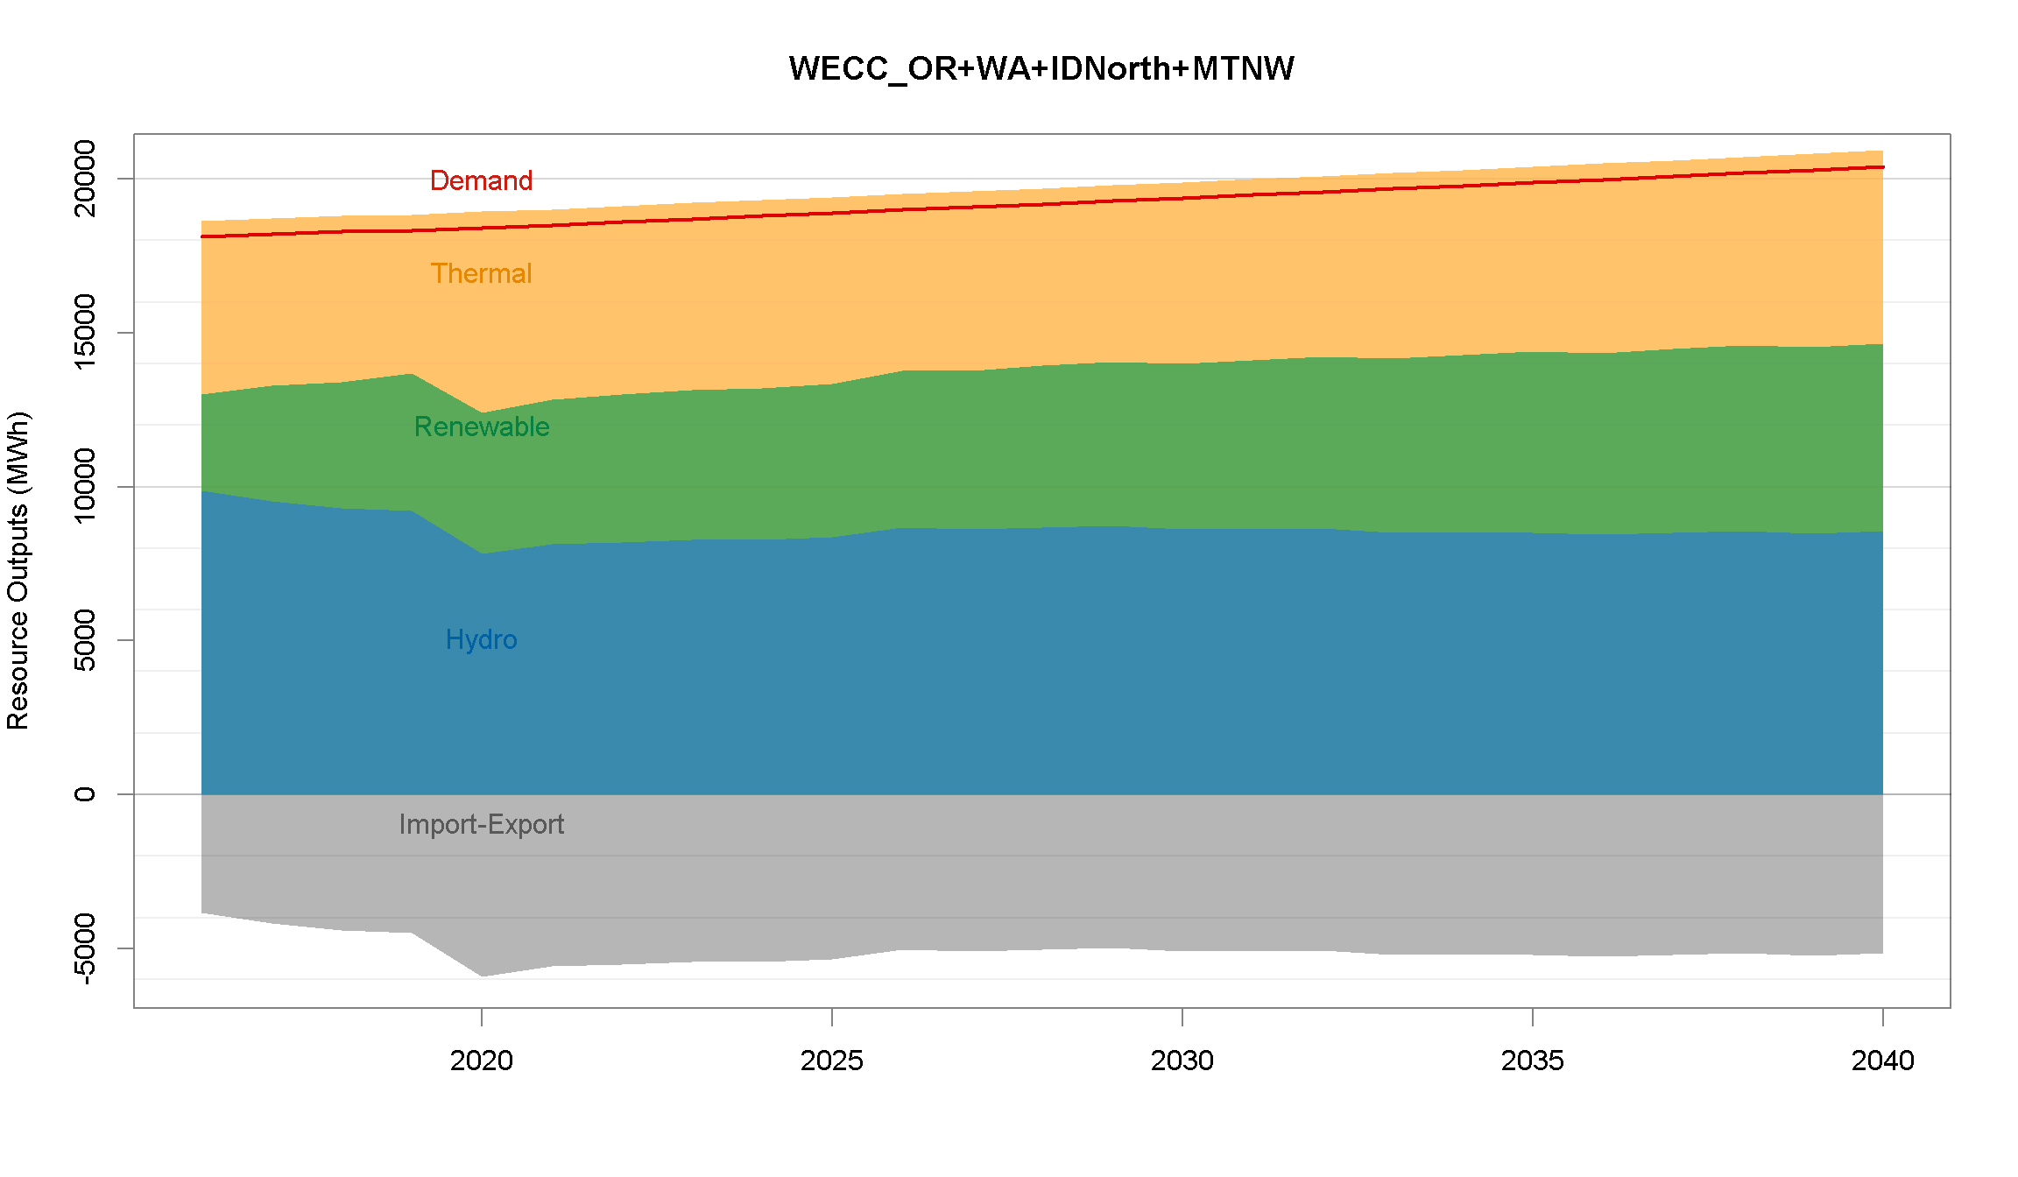
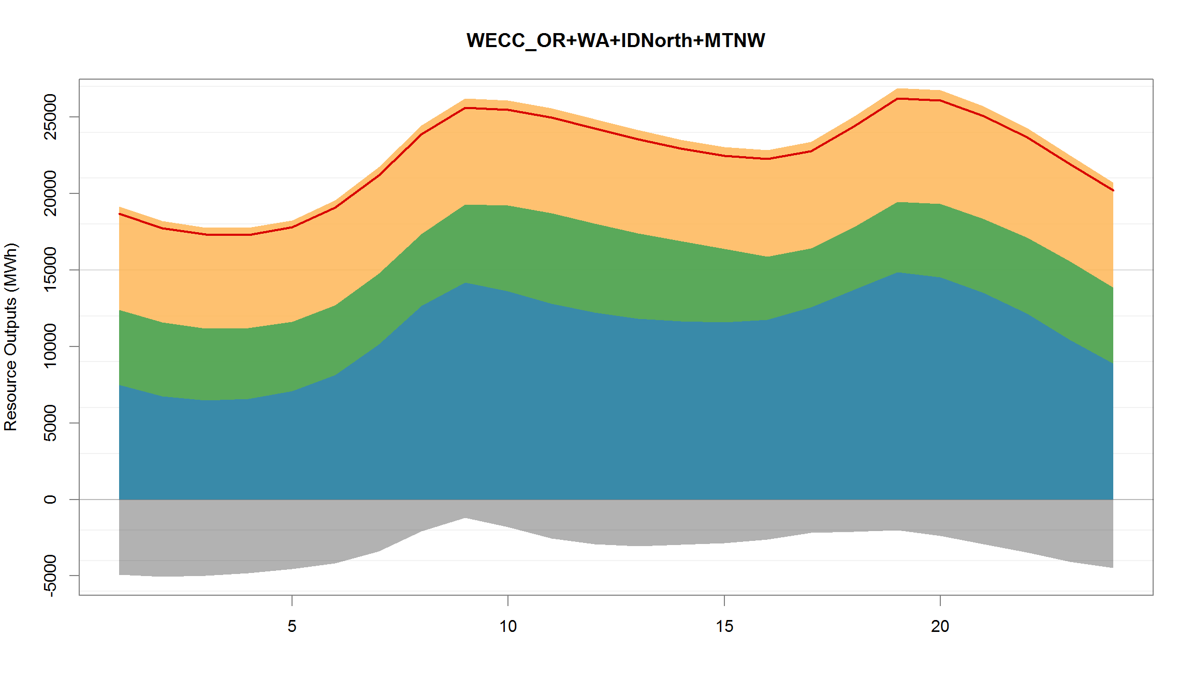
Resource Generation
How does resource mix change over time?
PNW Generation by Type: 2016-2040
PNW Generation by Type: HE1 - 24
How about over the course of a day?

Slide 8
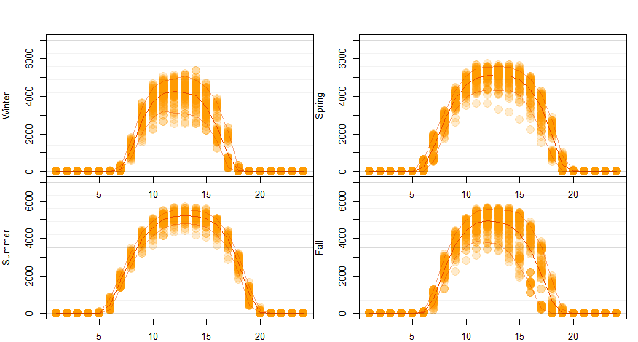
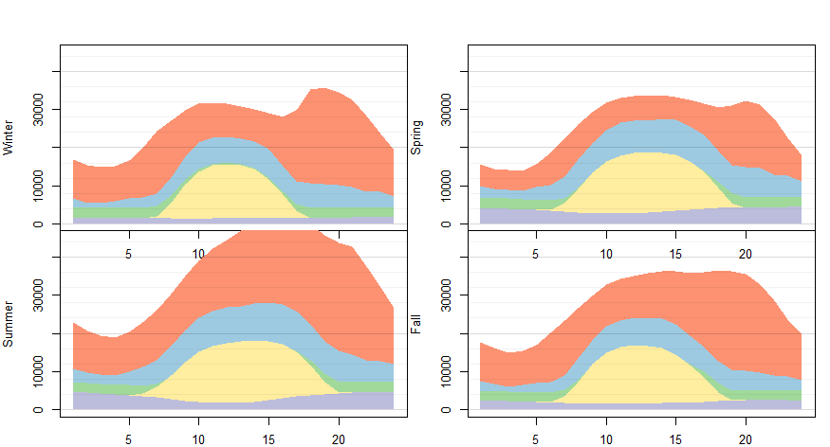
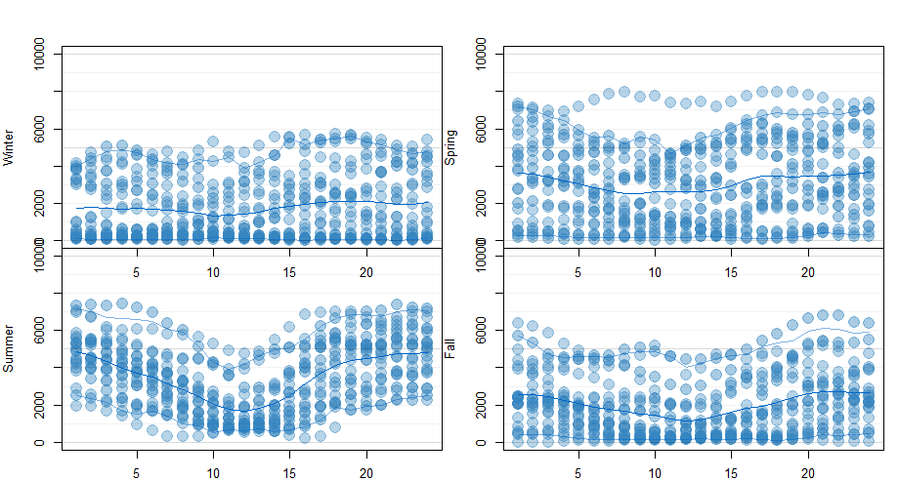
Variable Generation
Are hourly and seasonal variabilities of wind and solar generation captured?
How does it affect the overall resource mix?
California Solar Hourly Shapes by Season
California Generation by Season
California Wind Hourly Shapes by Season

Slide 9
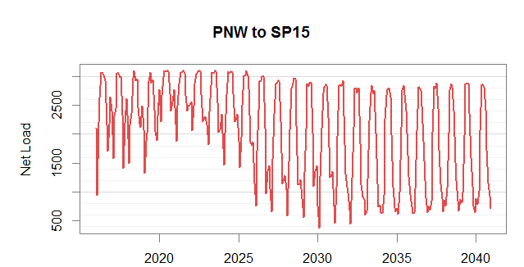
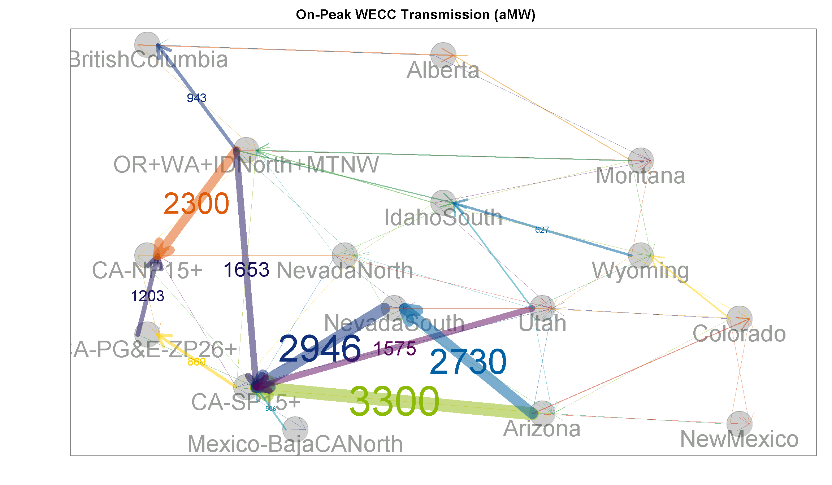
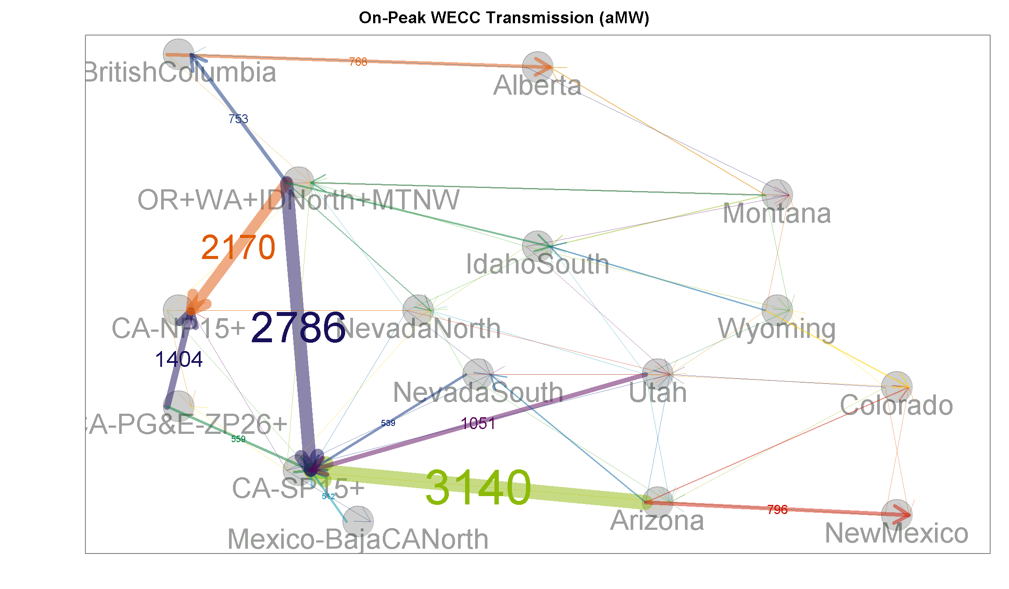
Transmissions
You can look at time series plot for each transmission lines….
Net Load from PNW to SP15: 2016-2040
Net Load in WECC: 2035
Net Load in WECC: 2020
But it’s more insightful to see all transmission lines together, and how it changes over time.

Slide 10
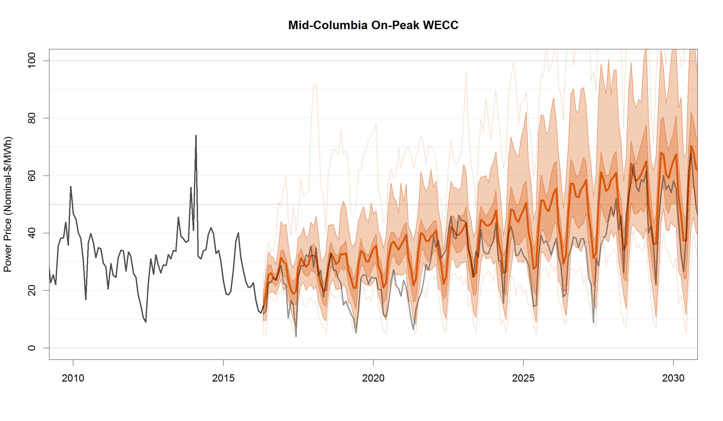
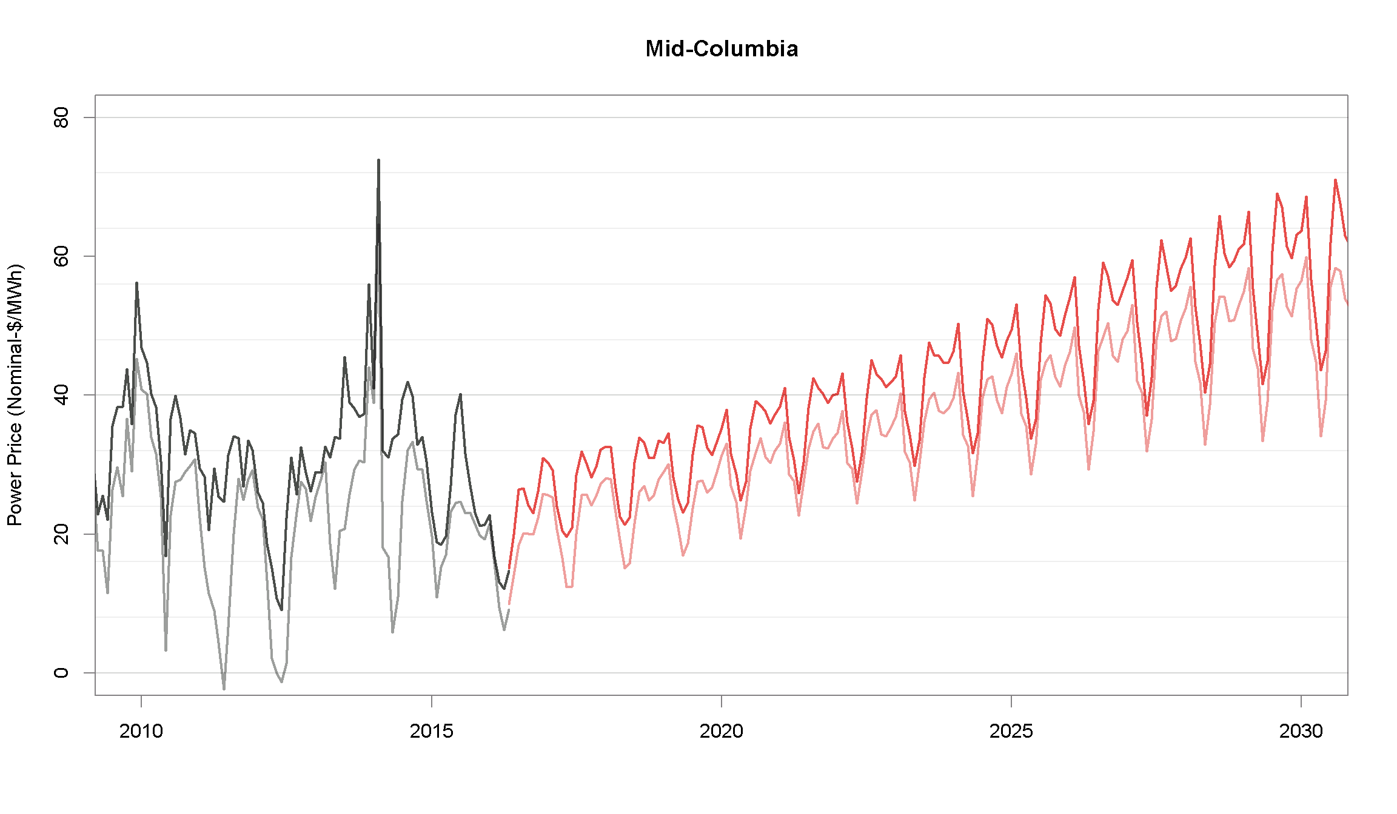
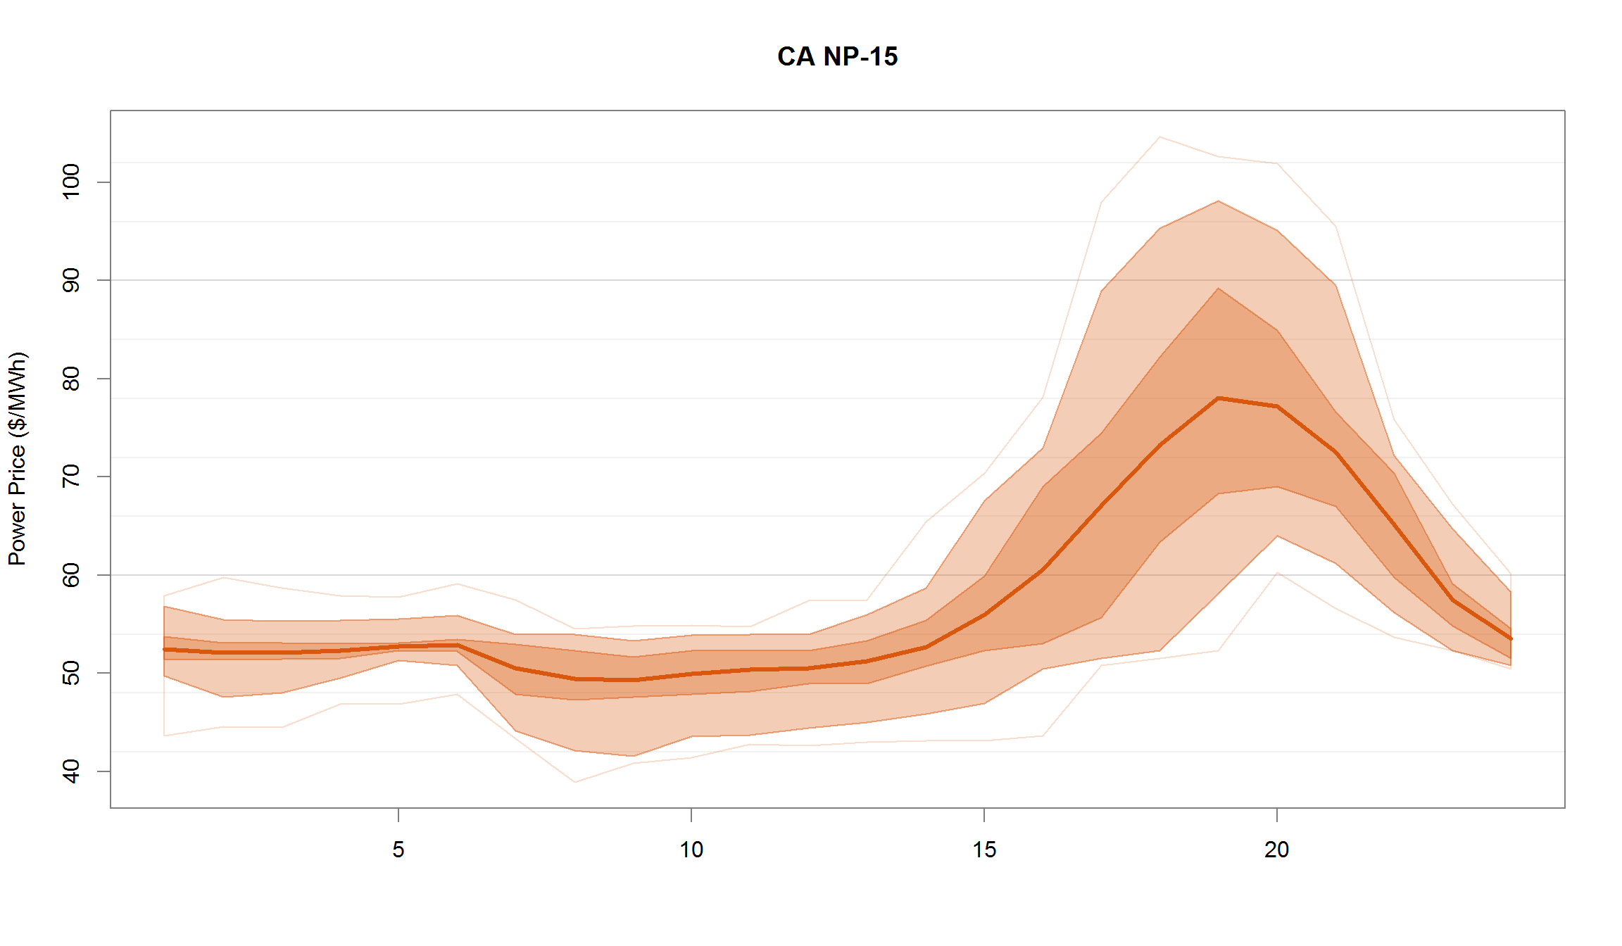
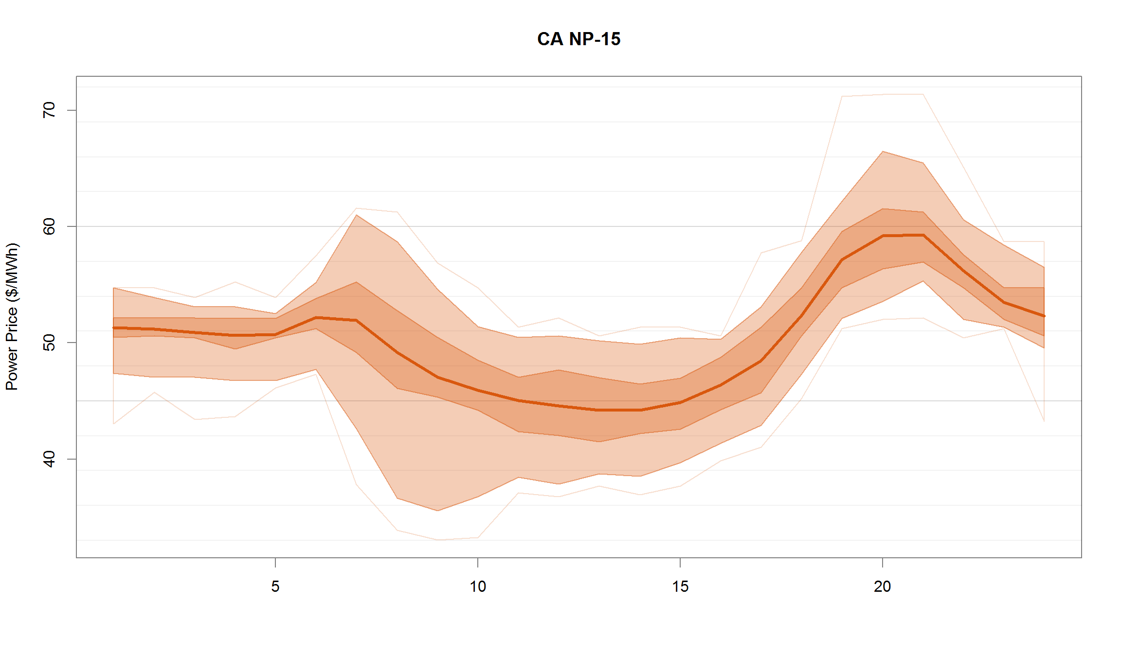
Market Prices
You can look at monthly power prices…
Stochastic power prices…
Mid-C Power Price: 2016-2040
California NP15: 2026- Summer
California NP15: 2026- Spring
Hourly power prices…
Of different seasons…

Slide 11
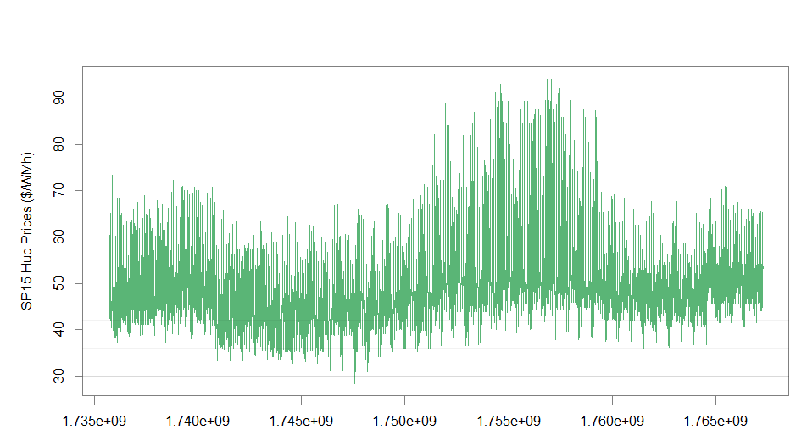
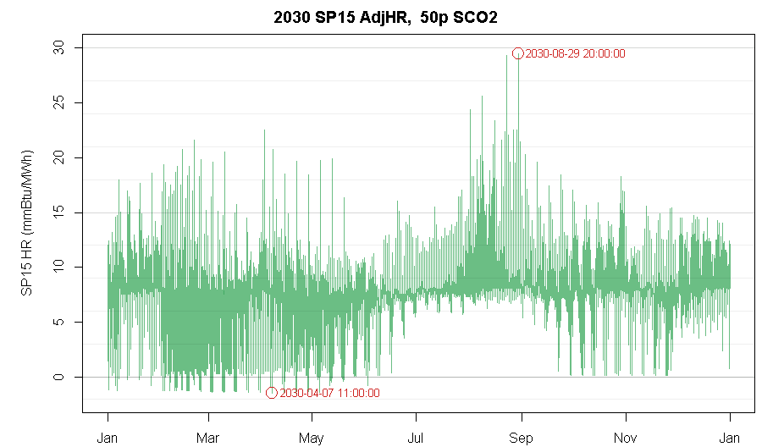
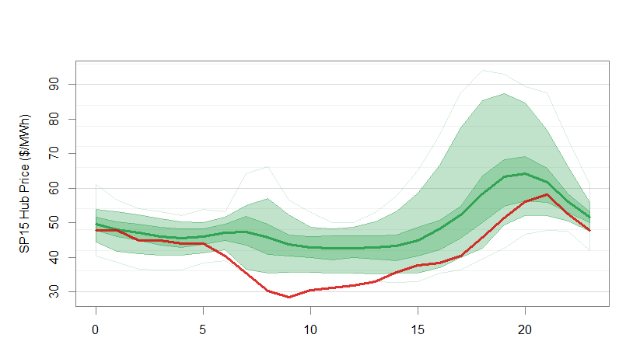
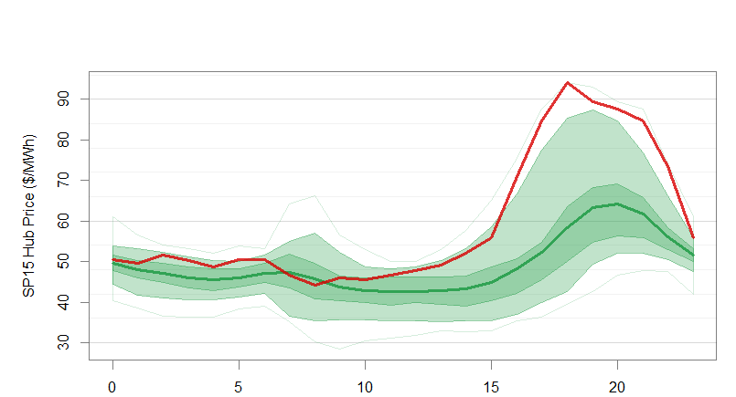
Extreme Days
You may want to analyze what is driving extreme days…
Generation
Resource Stack
Transmissions
SP15 Hourly Power Price: 2025

Slide 12
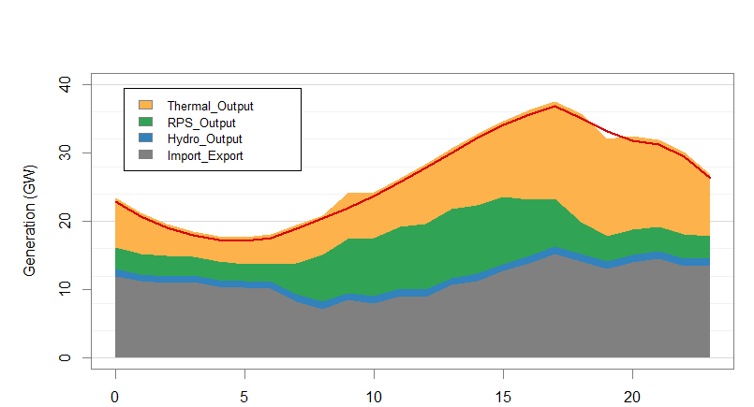
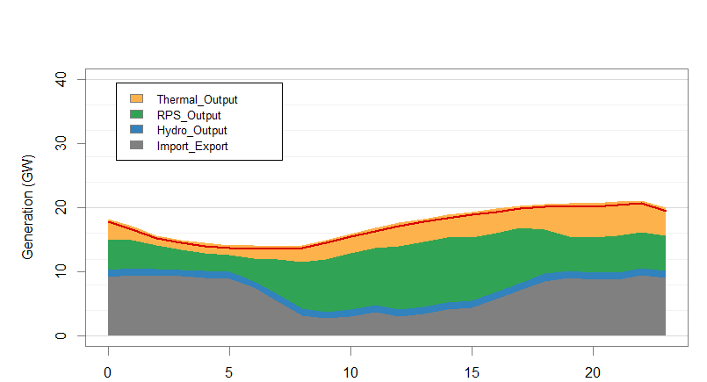
Extreme Days
You may want to analyze what is driving extreme days…
Generation
Resource Stack
Transmissions
SP15 Hourly Power Price: 2025

Slide 13
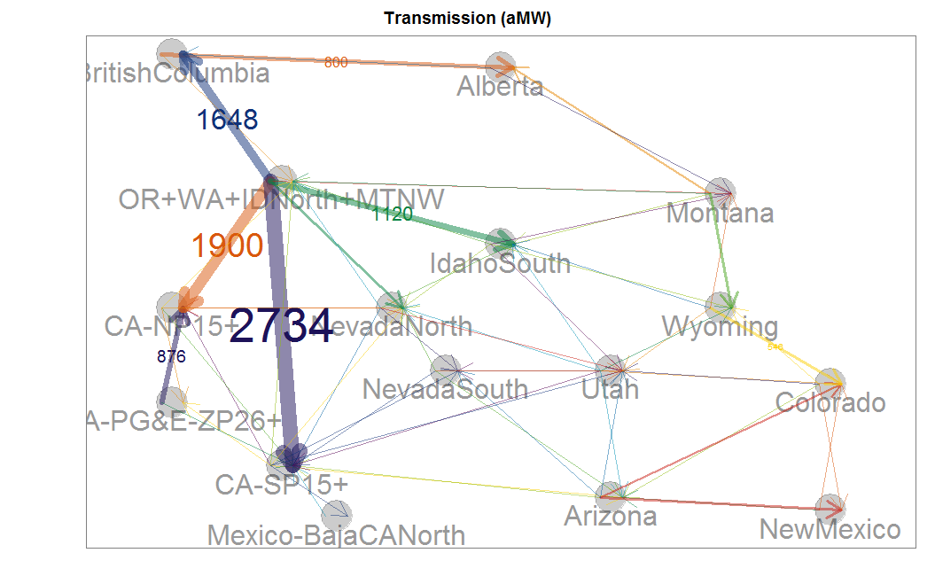
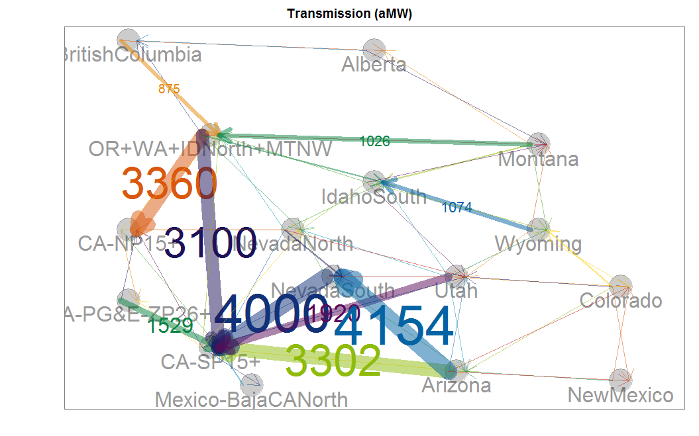
Extreme Days
You may want to analyze what is driving extreme days…
Generation
Resource Stack
Transmissions
SP15 Hourly Power Price: 2025

Slide 14
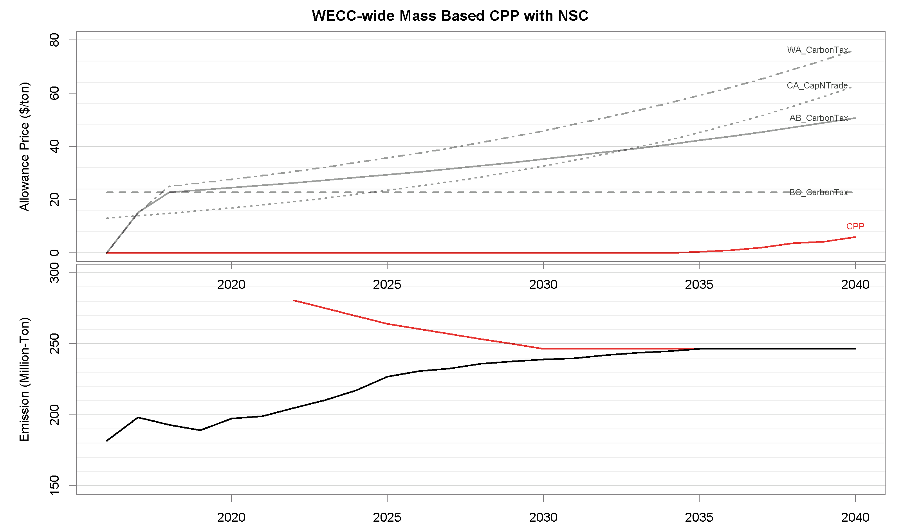
Carbon Emissions

Slide 15
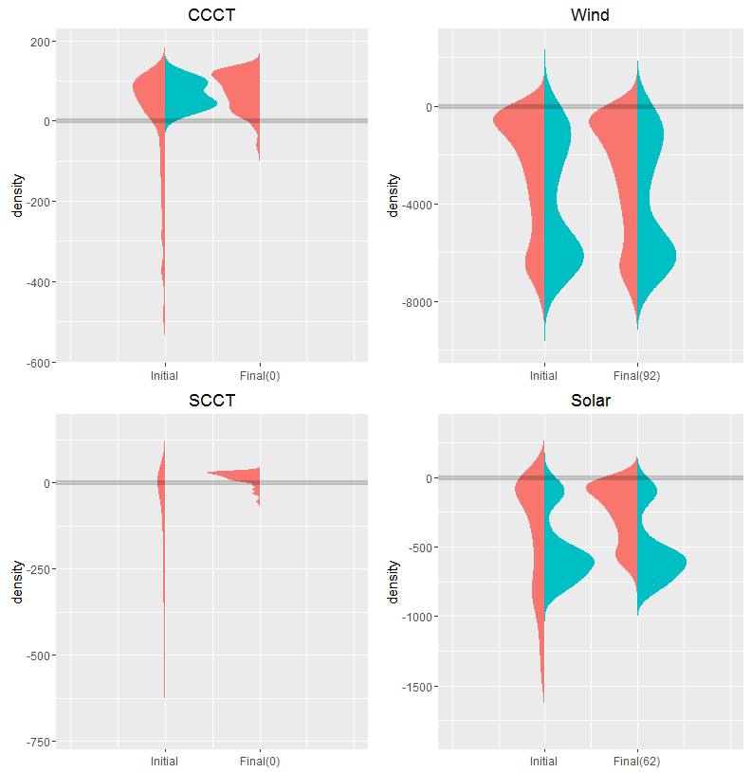
Long Term Diagnostics
What are the NPVs of potential resources at the begging and end of LT run?
How about NPVs of selected and unselected resources?
PNW Resource NPV
Unselected
Selected
NPV
NPV
NPV
NPV

Slide 16
How much Time & efforts Did I Spend in generating these plots?
Modeling & Reporting Procedures

Slide 17
Project-Based Modeling Routines
Update model inputs
Pause the model and check results
Run
Validation & Report
Model Building
Research markets
Project Requirements
Waiting…
Final Report
Generate a report and validate results

Slide 18
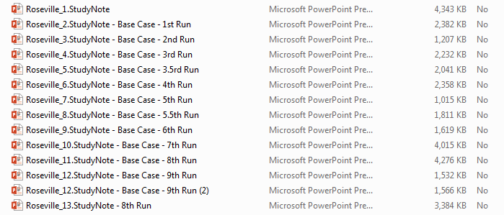
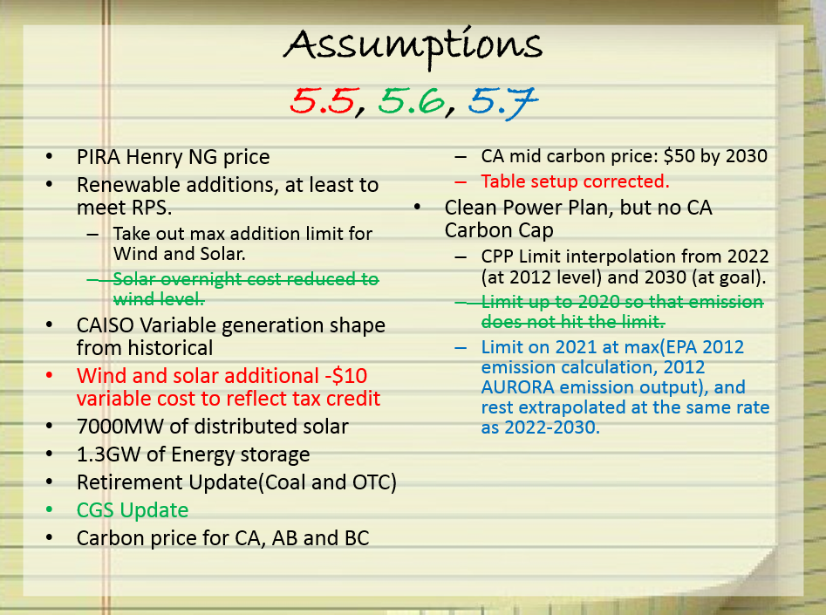
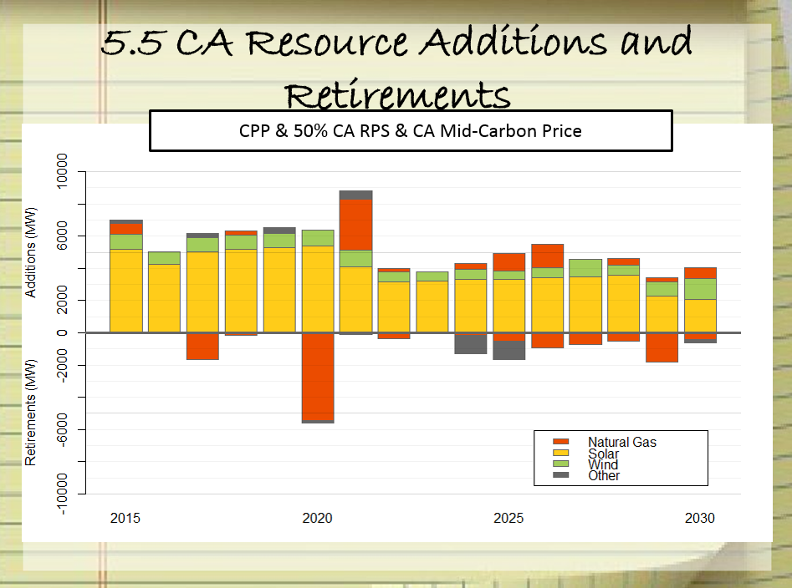
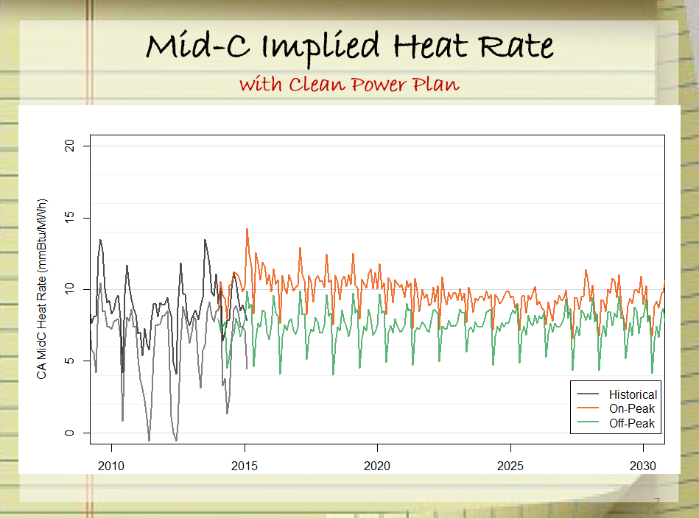
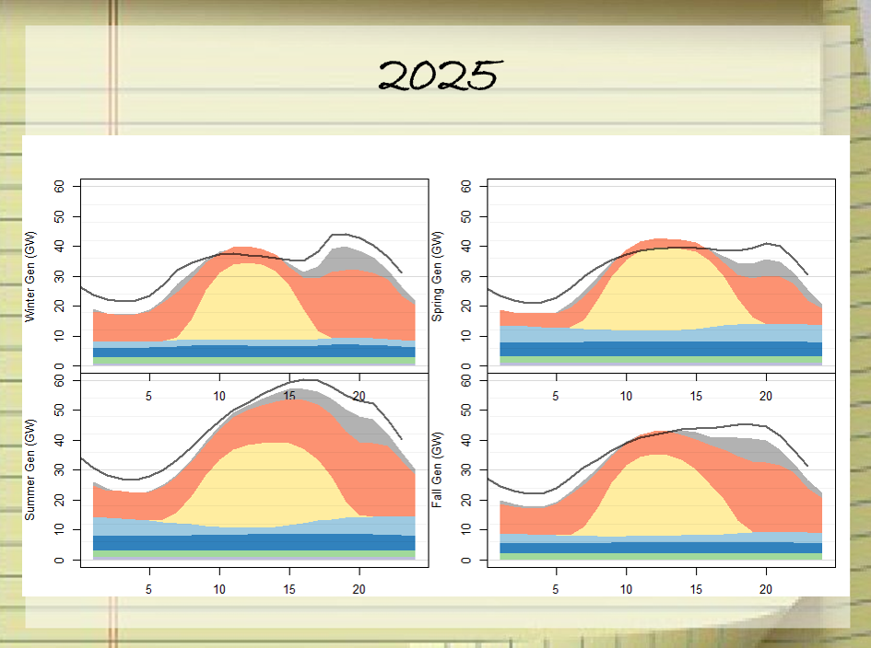

My Reports in 2015
…
Notes:
How many times do you click to make a 20 slide deck? 20 images x 5~10 clicks/image = 100~200 clickes per deck.

Slide 19
Let’s do it better!
Reporting Tools

Slide 20
Audience Survey
Data Management
xmpSQL
SQL Server / MySQL
XML / Zipped XML
Other…
Visualization
AURORAxmp’s built-in plotting tools
Excel
Commercial BI tools
R
Other…

Slide 21
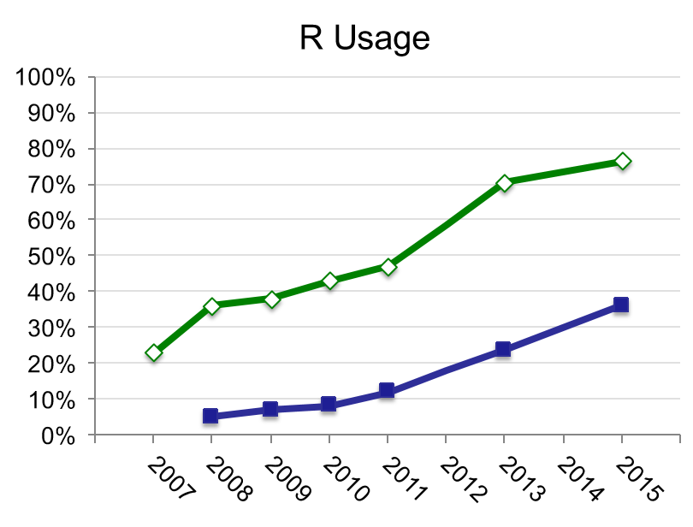
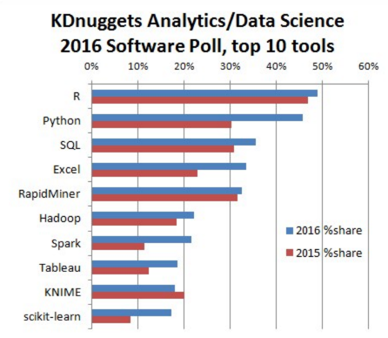
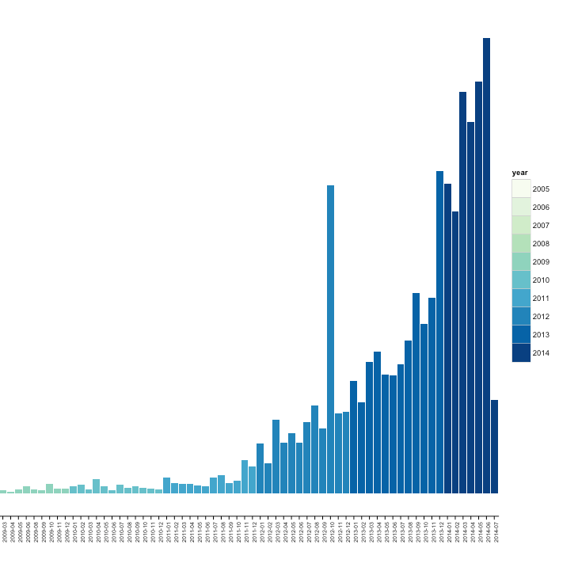
R
R is a free and open-source software environment for statistical computing and graphics.
Widely used among statisticians, data miners and data scientists.
Number of R Packages Published
(source: Rexer Analytics 2015 Data Miner Survey, provided by Revolution Analytics)

Slide 22
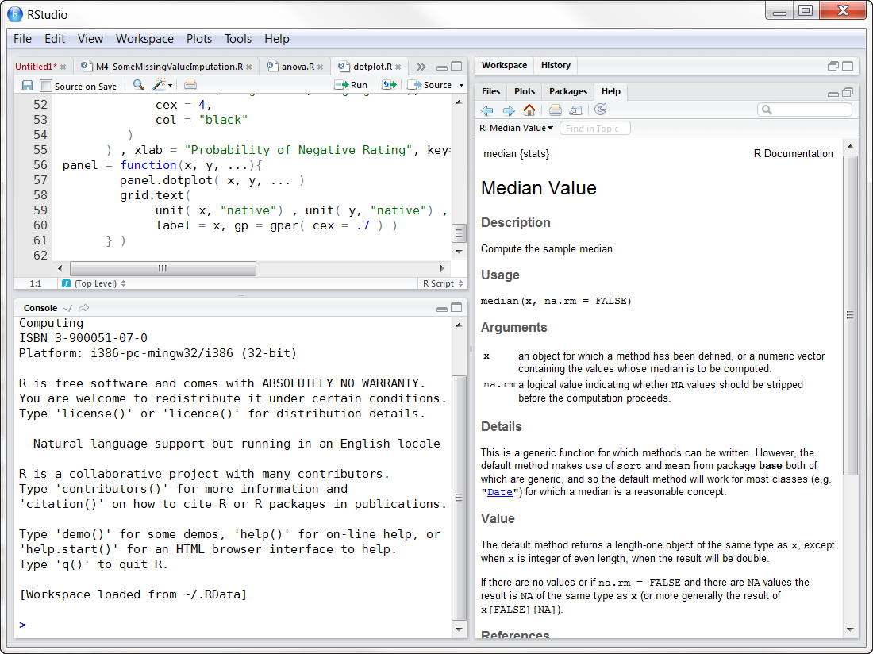

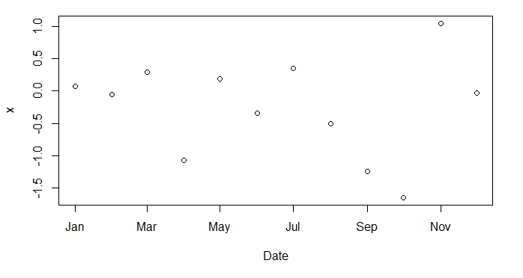
RStudio
RStudio is a free and open-source integrated development environment (IDE) for R.
Want:
Import data from “data.csv.”
Plot the data.

Slide 23
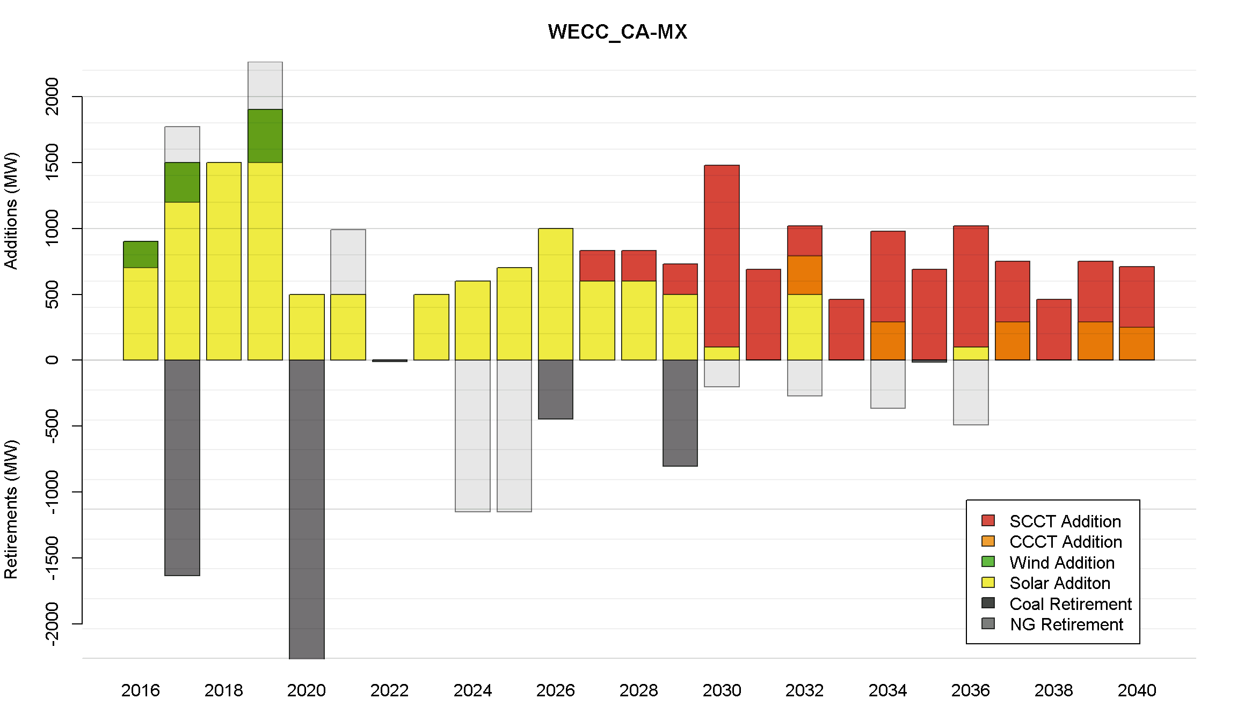

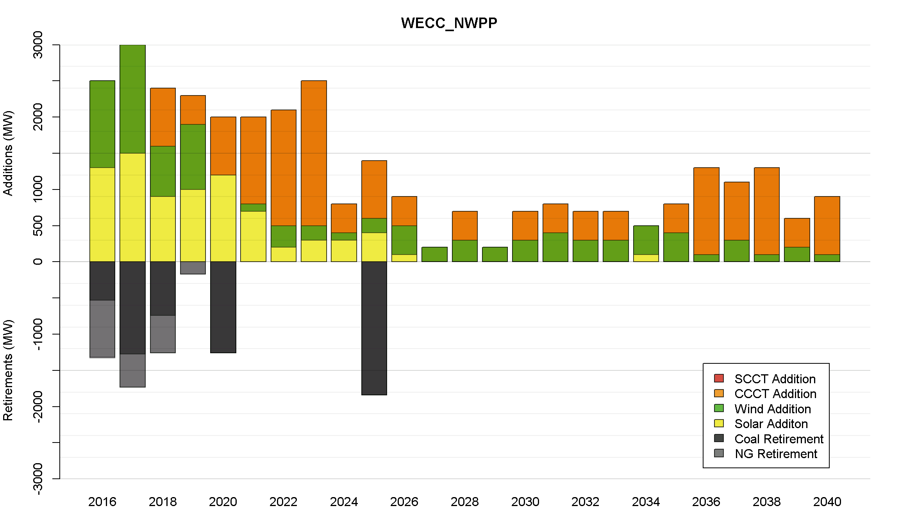
How to Produce Result Plots in R
Import output data from a database (or csv files).
Do some cleaning and joining of output tables.
Define a plotting function.
Plot.

Slide 24
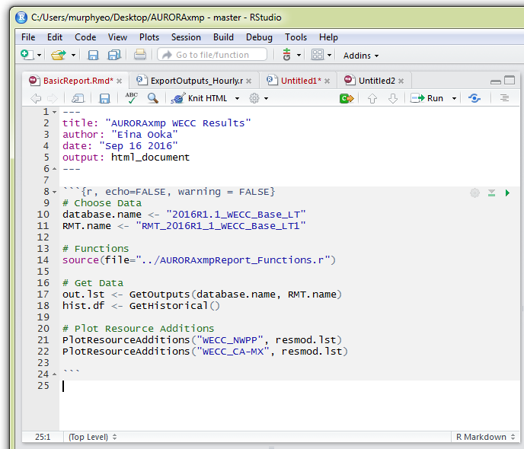
Knit HTML
I want certain plots every time a model is run.
Build a reproducible report using Rmarkdown.

Slide 25
Shiny App Demo
My Reports in 2016

Slide 26
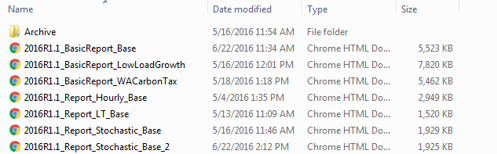
Report
Collection of flat files in HTML,
which looks like…

Slide 27
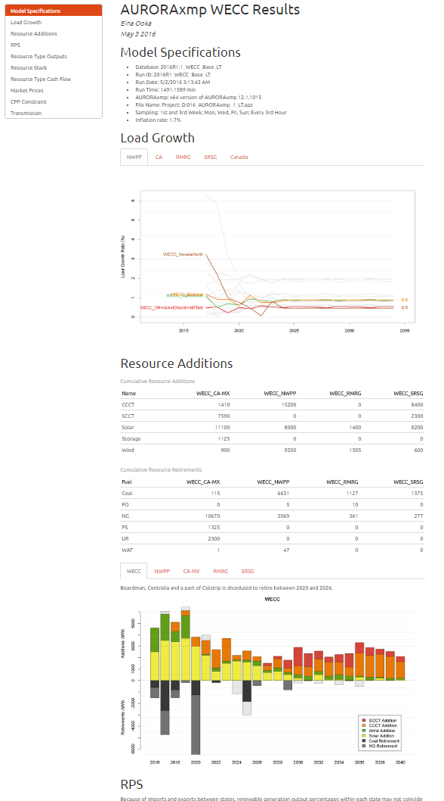
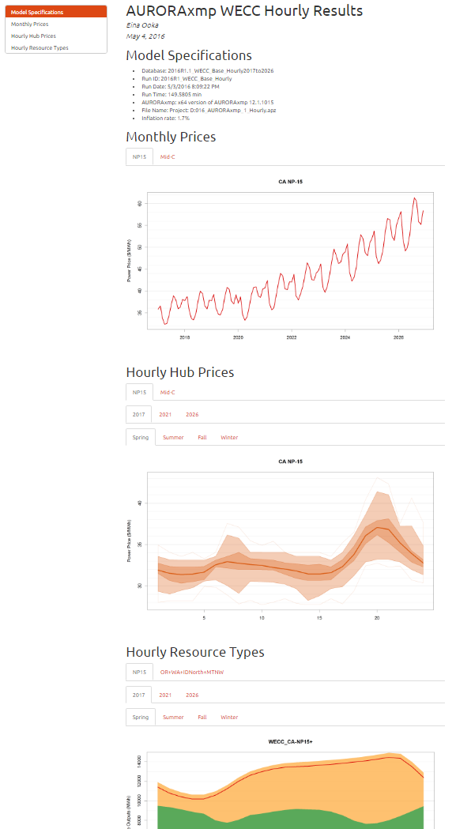

Slide 28
Interactive UI for Reporting
R package called ‘Shiny’ enables easy creation of interactive web UI.
Anybody can explore results.
Easy modification of reporting time period.
Add comments in reports.

Slide 29

Summary
Visualizing results gives us a lot more insights into what’s happening in simulated market results.
R has an ability to expand graphics/visualization capability.
Rmarkdown produces reports as a matter of a click after a simulation run. (Bye-bye clicking knots!)
You are encouraged join R community as a new R programmer, but you can also contact The Energy Authority for assistance with developing these tools.

Slide 30
Thank You!
Contact: Eina Ooka (eooka@teainc.org)

